Slide 1
ELEC 4511/5511
Hardware Software Design
Lecture 25
Implement linear regression on PYNQ board
Part 2: Hardware-Software Co-design

Slide 2
Linear regression implementation on PYNQ board
AXIS_linear_regression
X, Y, theta
gradient_calc
Prepare the data package (batch)
Send data to DRAM
Gradient decent (update theta)
theta_new
PS
PL

Slide 3
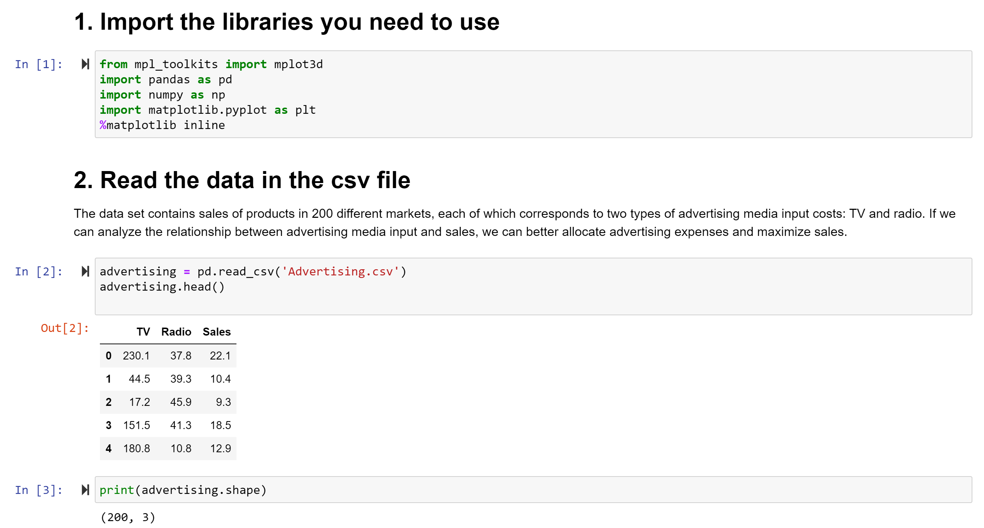

Linear regression implementation on PYNQ board

Slide 4
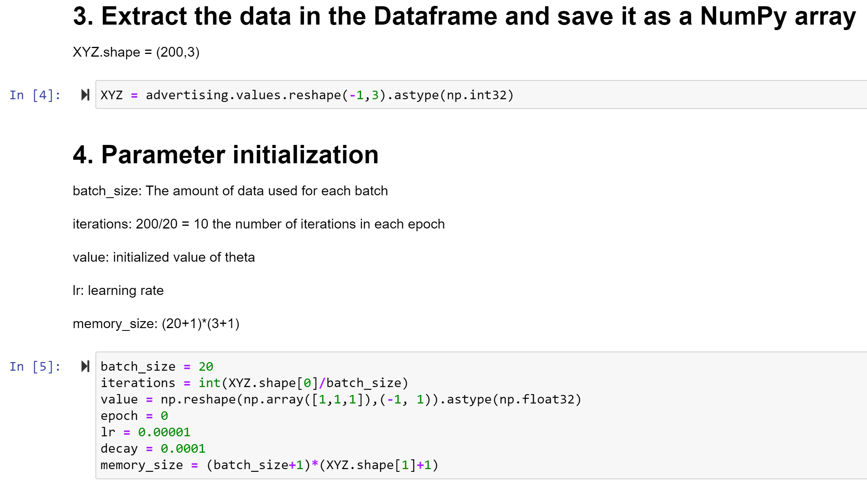
Linear regression implementation on PYNQ board

Slide 5
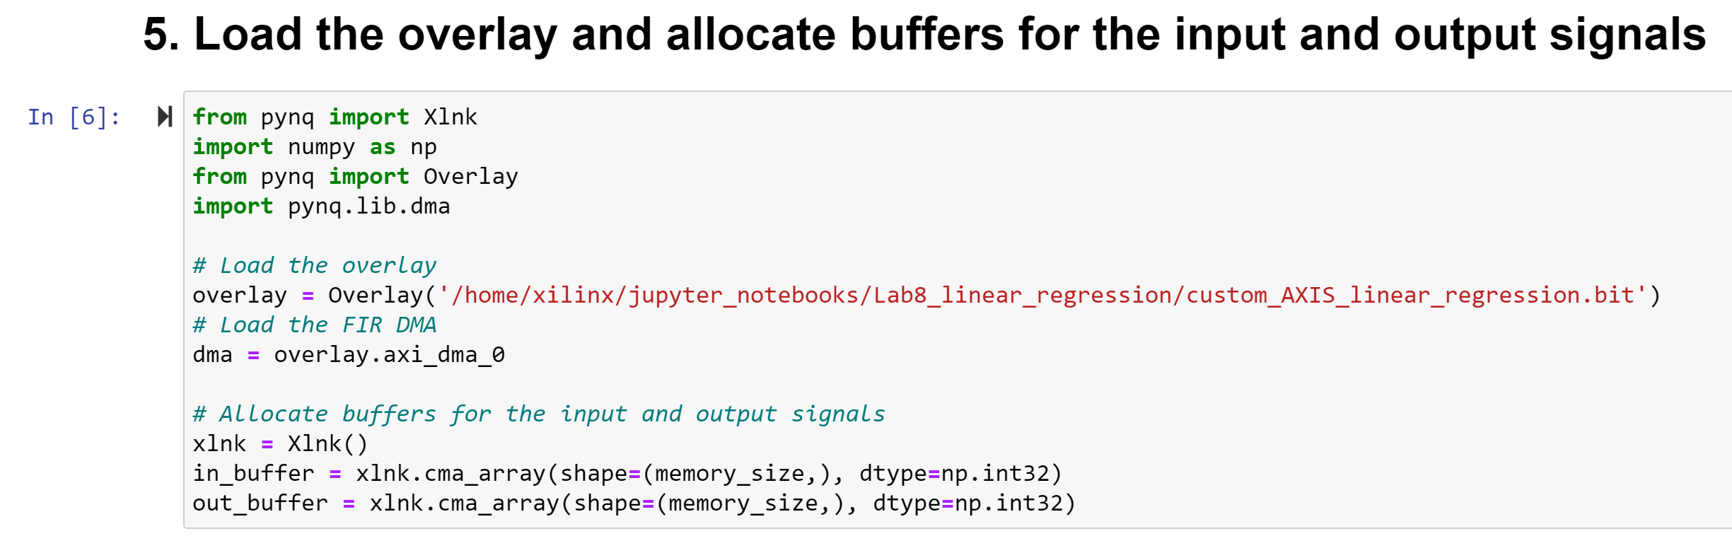
Linear regression implementation on PYNQ board

Slide 6
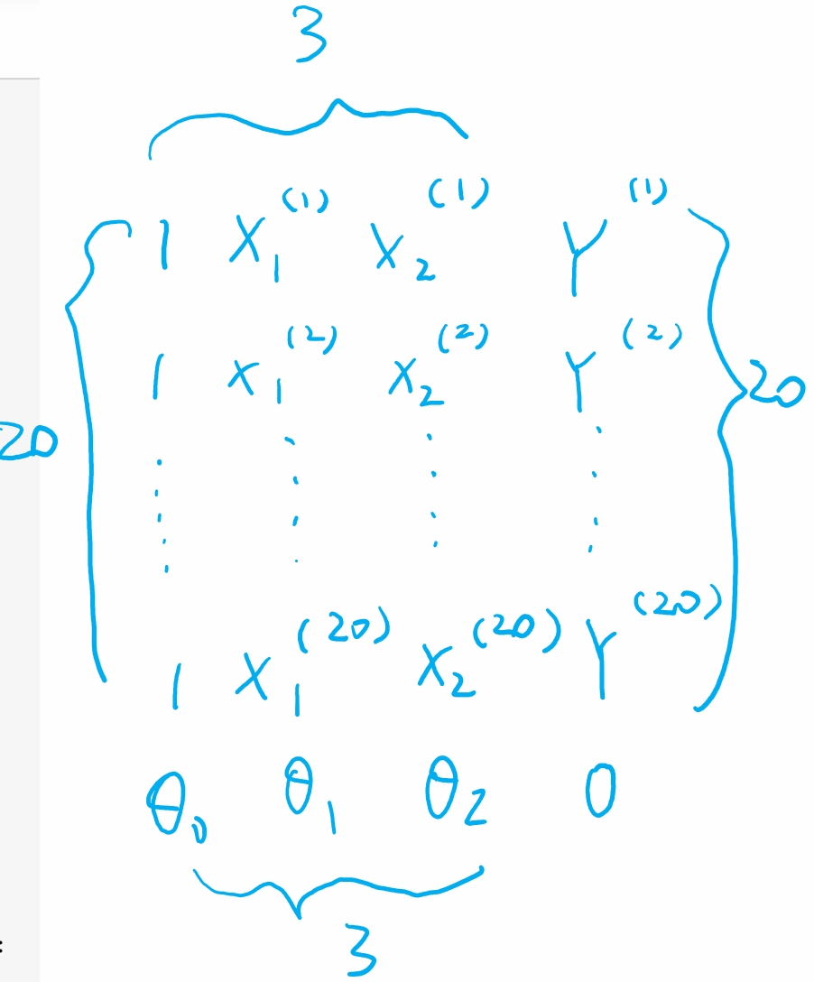
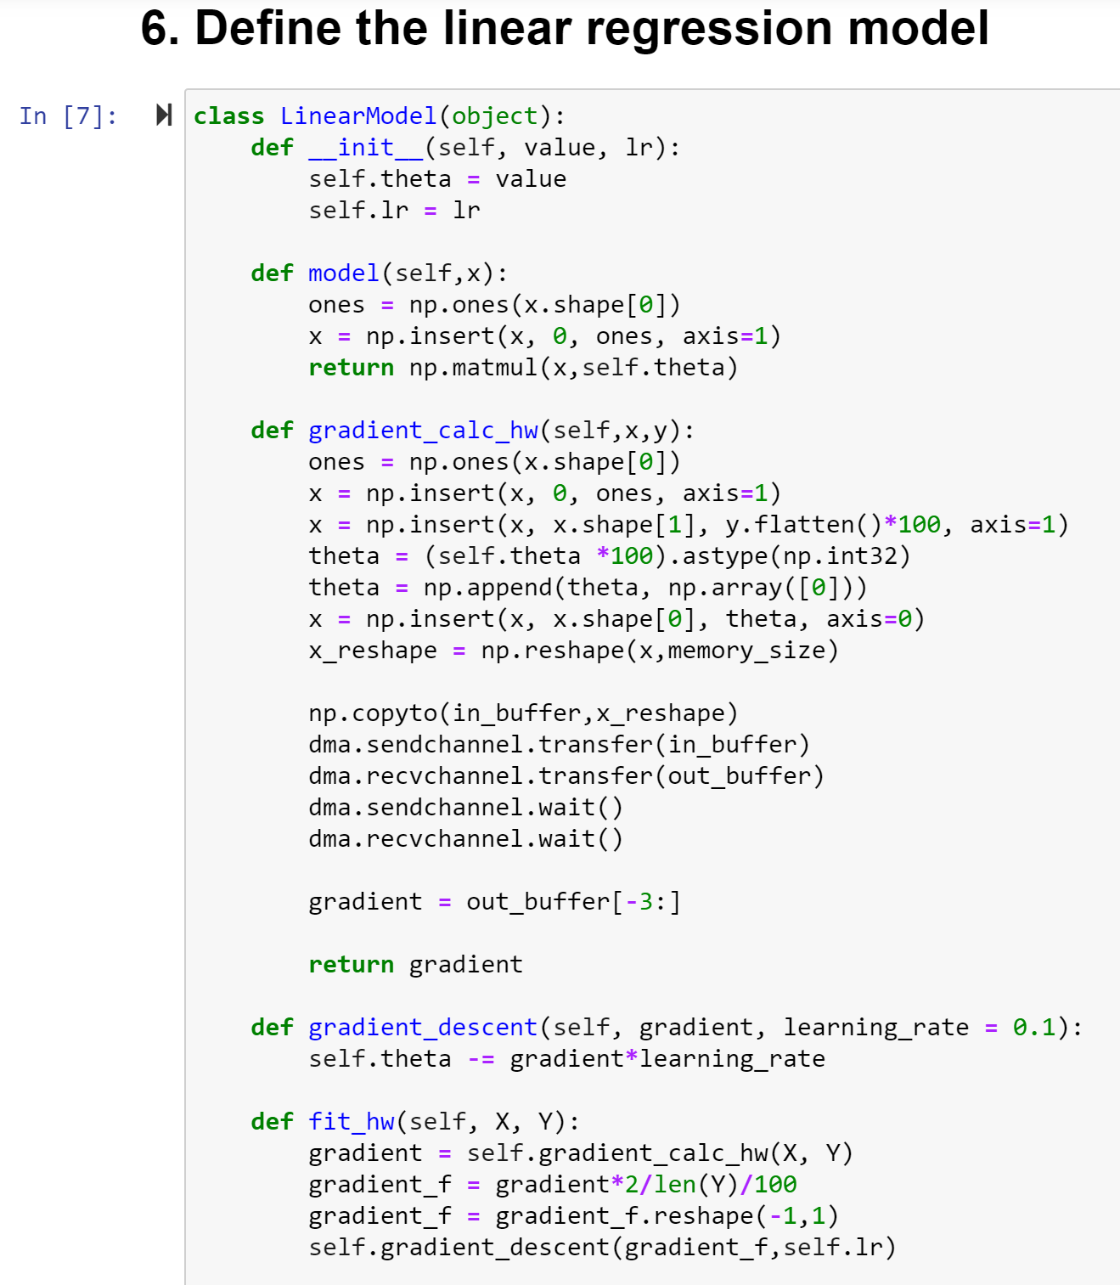

Linear regression implementation on PYNQ board

Slide 7
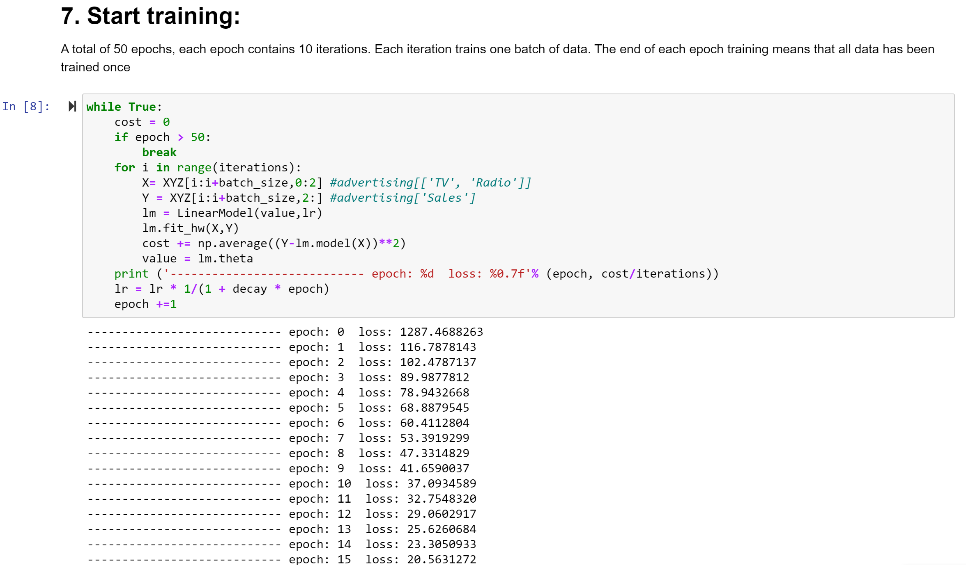
Linear regression implementation on PYNQ board

Slide 8
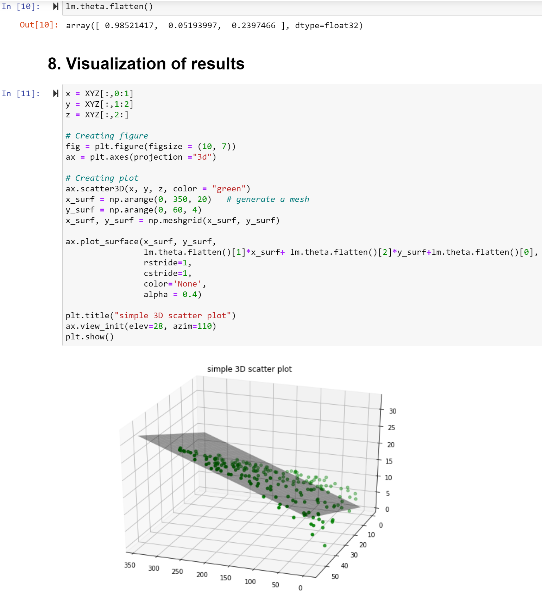

Slide 9
AXI Stream wrapper design
s00_axis_aclk
m00_axis_aclk
s00_axis_aresetn
X
m00_axis_aresetn
s00_axis_tdata
*Data
send out
m00_axis_tdata
Y
gradient_calc
s00_axis_tlast
m00_axis_tlast
s00_axis_tvalid
m00_axis_tvalid
s00_axis_tready
ϴ
m00_axis_tready
AXIS_linear_regression
M_AXIS_MM2S
AXI_DMA
S_AXIS_S2MM

Slide 10
Linear regression implementation on PYNQ board
Save streaming input data to vectors: X, Y, theta
This part is triggered by “s00_axis_aclk”
Start transmission when “s00_axis_tvalid & s00_axis_tready_reg” is true
Send a “prepare_data_done” signal at the end of the transmission to indicate that the calculation result (gradient_vector) can be returned (you may use a counter)

Slide 11
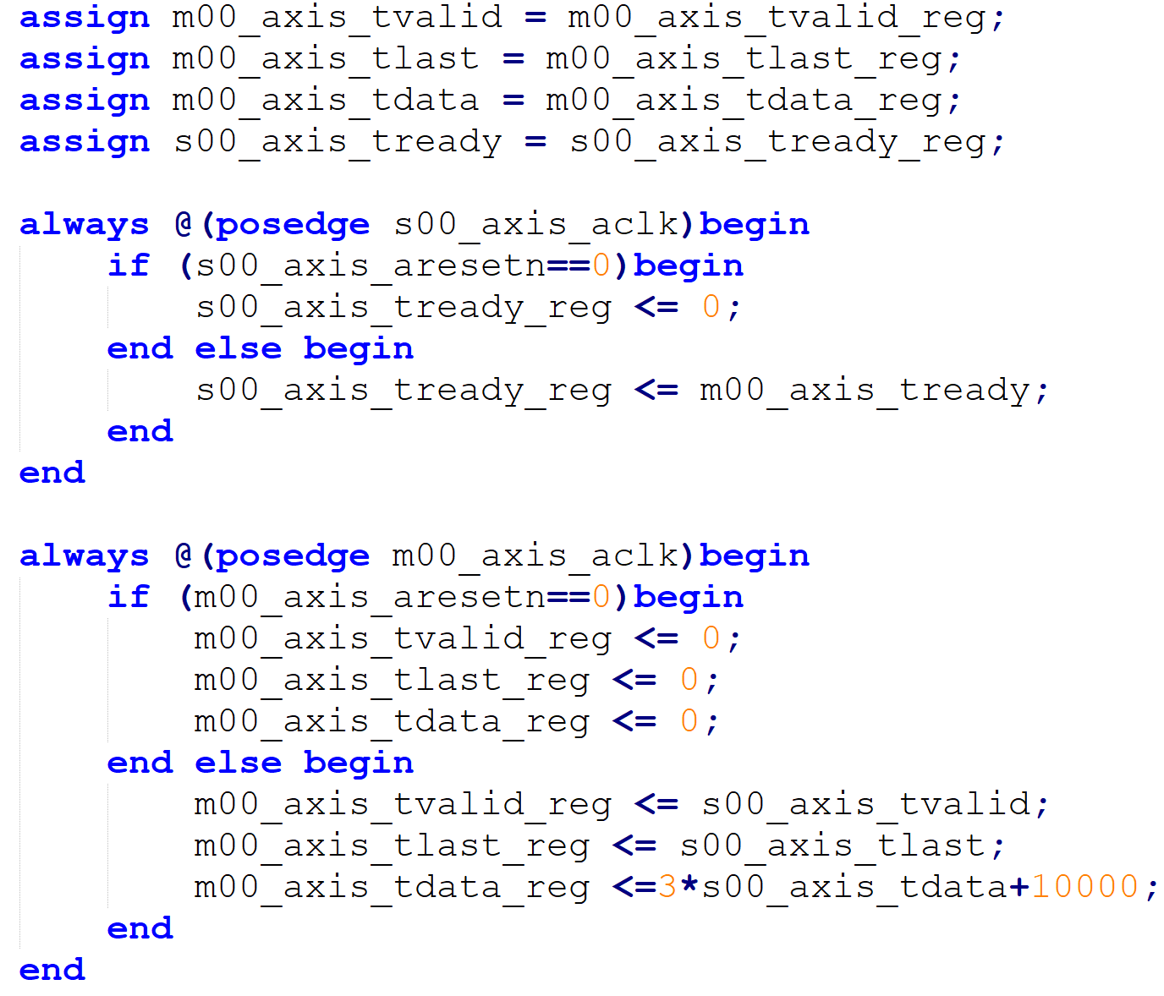
Linear regression implementation on PYNQ board
2. Send out the calculation result
This part is triggered by “m00_axis_aclk”
Start transmission when “m00_axis_tready & prepare_data_done ” is true
You need 3 clock cycles to send “gradient_vector”
“m00_axis_tlast_reg” and ‘“m00_axis_tvalid_reg” signals should be delayed by 3 clock cycles.
“Stream_ip” from previous lectures

Slide 12
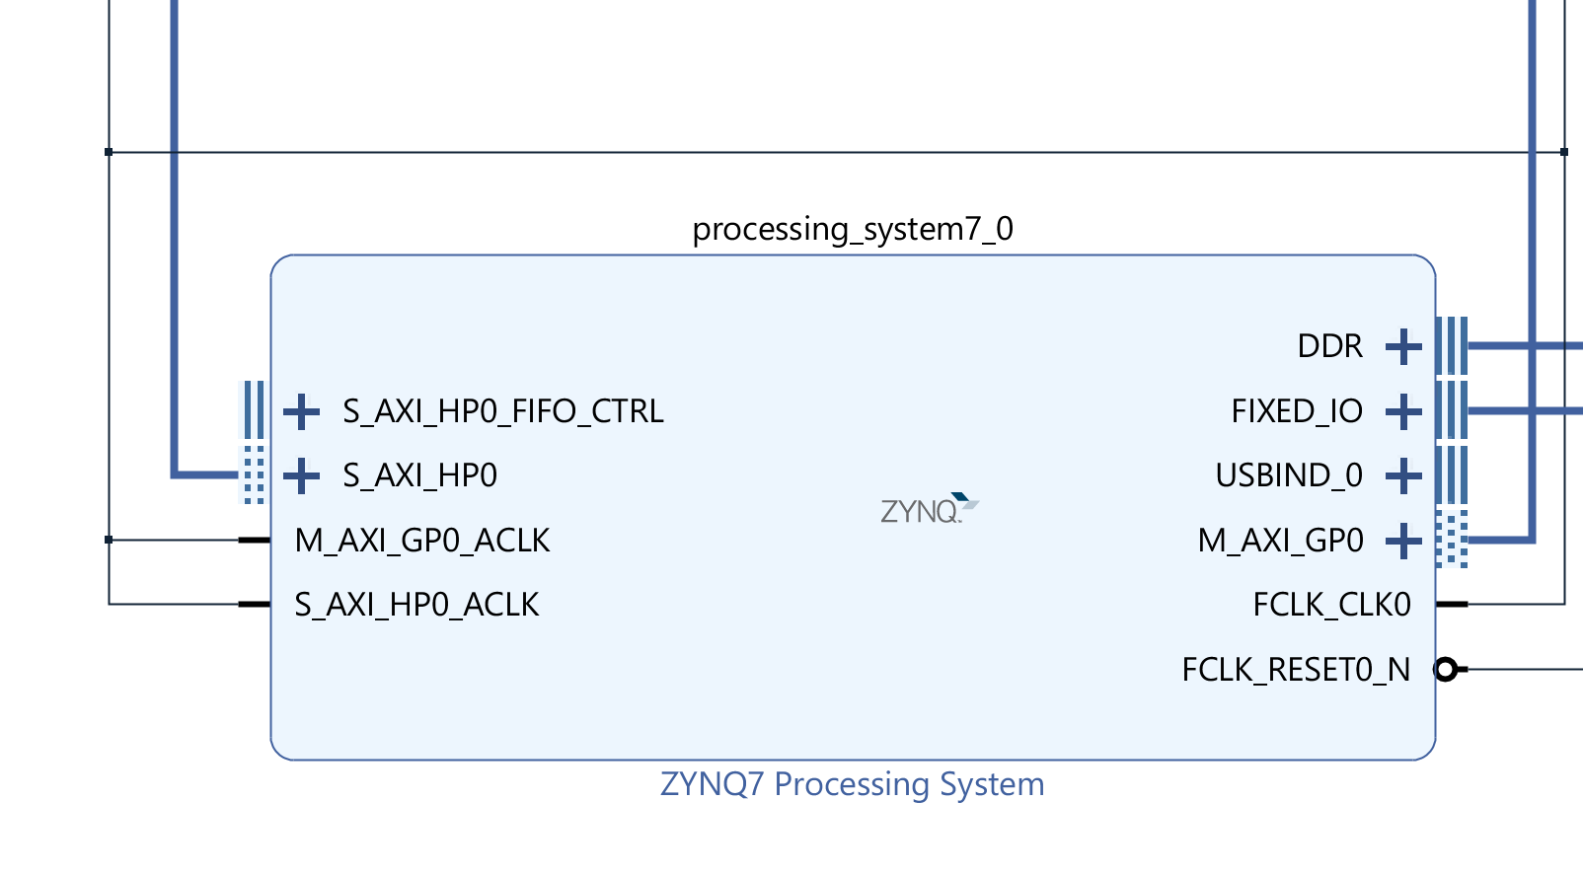
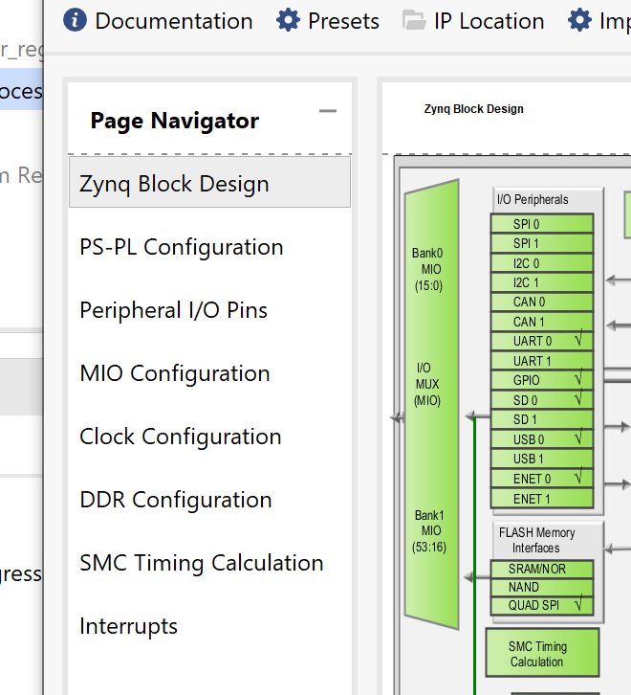
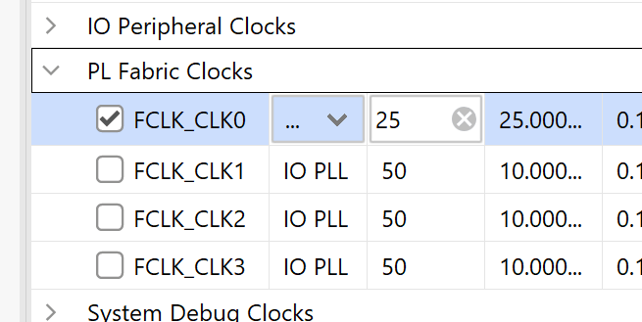
Linear regression implementation on PYNQ board
Simply solve the timing issue with decreasing the clock speed

